Slide 1
Programming in java
The prerequisite information before start

Slide 2
What comes to you mind when you think of “programming”?

Slide 3
What is programming ?
Its way of thinking and way to solve a specific problem by certain Algorithms to perform computing for different purpose.
What is Algorithms :-
The steps itself to solve to current problem.

Slide 4
programming story ?
When the revolution of the electricity raised up in and the concept start of machine start to show up and they think of way to start to control machine so the “machine language”.
Machine language its language use to communicate with machine by bits (0 ,1)
0 refer that’s no electricity founded
1 refer that’s electricity founded
From here they start to expand these concept by byte that contain 8 bits to increase possibility of communication with machine they start to think how performs operation on this bits so logic gates comes in . Actually this very complex.
So inventors start to create programming languages.

Slide 5
The level of programming languages
After invented the programming languages they start to classify it depends on how it far from the machine language
The low programming language its more acting with hardware
Like Assembly language
Mid Programming Language like C++
High Programming Language like python

Slide 6
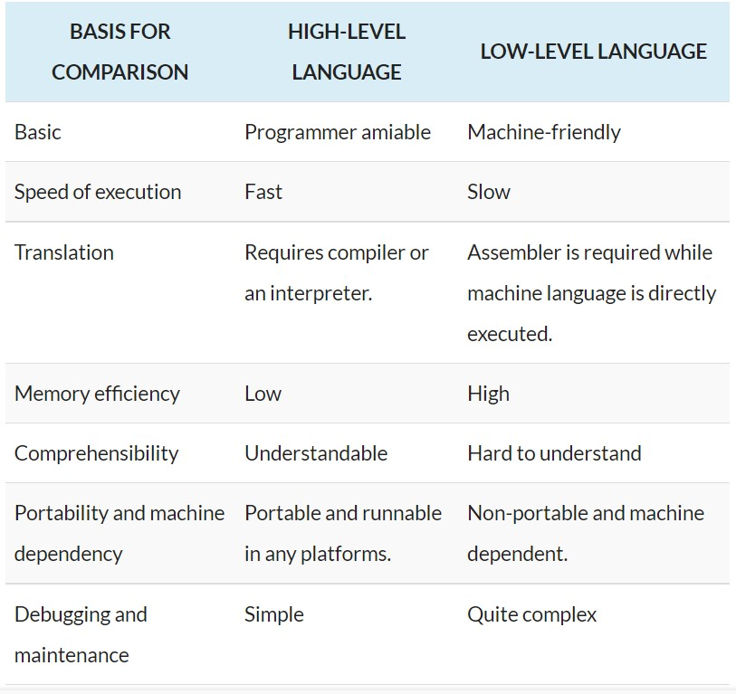

Slide 7
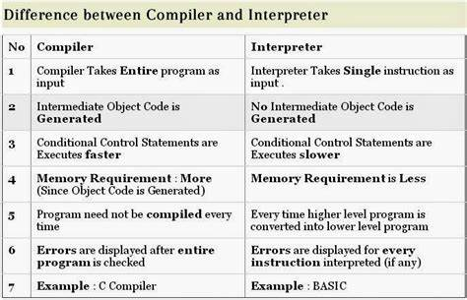
How is machine understanding programming language ?
There is intermediate translator called compiler or interpreter (depends on the language) that translate programming language to machine language.

Slide 8
Where you going to write code ?
. From command line
That is a useful skill for troubleshooting, but for most day-to-day work
. From Integrated Development Environment (IDE)
you should use an integrated development environment. These environments are so powerful and convenient that it simply doesn’t make much sense to labor on without them. Excellent choices are the freely available

